Slide 1
Sense Of Agency Modeling

Slide 2
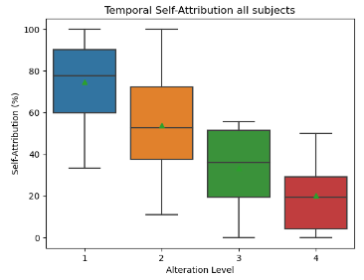
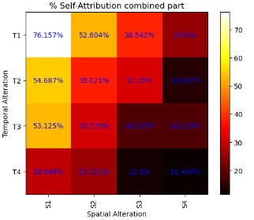
T1 Vs. T1S1 Distinction

Slide 3
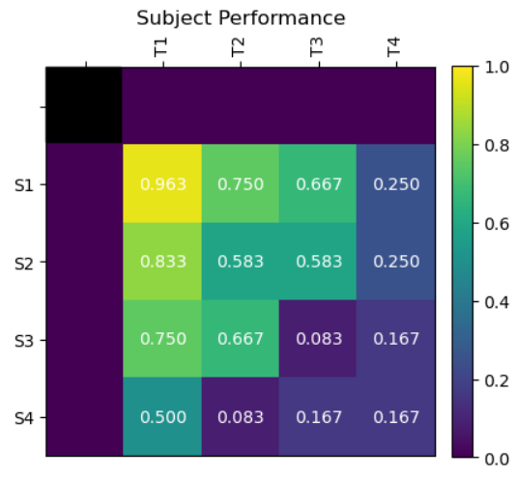
Goals
subject 166 as an example:
First, we aim to find the empty purple cells that best fit the model equation.
Evaluate how well the model can predict the subject’s answers.
Compare the models.

Slide 4
Models
Null
Multiplicative
Minimum
Mean
Temporal-Only
Spatial-Only
* Constraint

Slide 5
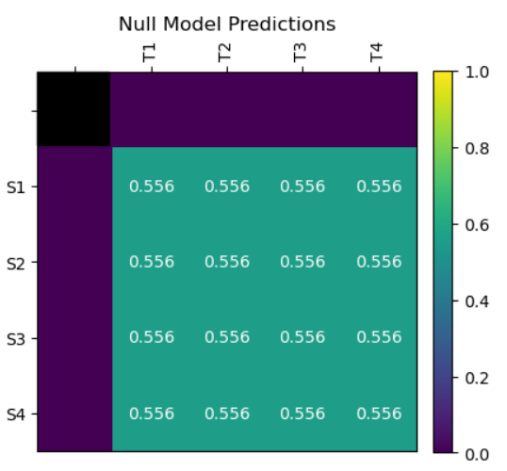
Null Model (“baseline”)
1 Parameter
Defined as mean(answers)
answers = [1, 1, 1, 0, 1, 0, 0]
mean(answers) = 0.5714.

Slide 6
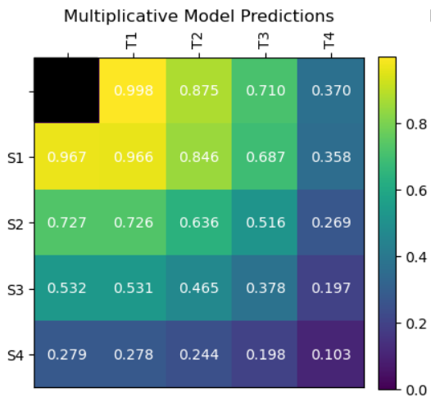
Multiplicative Model
8 Parameters (s1, s2, s3, s4, t1, t2, t3, t4)
Defined as sLevelValue * tLevelValue.

Slide 7
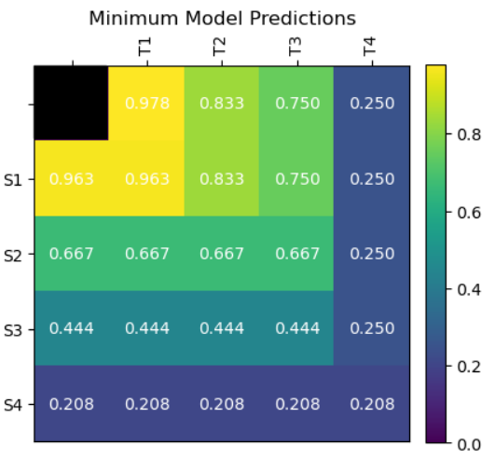
Minimum Model
8 Parameters (s1, s2, s3, s4, t1, t2, t3, t4)
Defined as min(sLevelValue, tLevelValue).

Slide 8
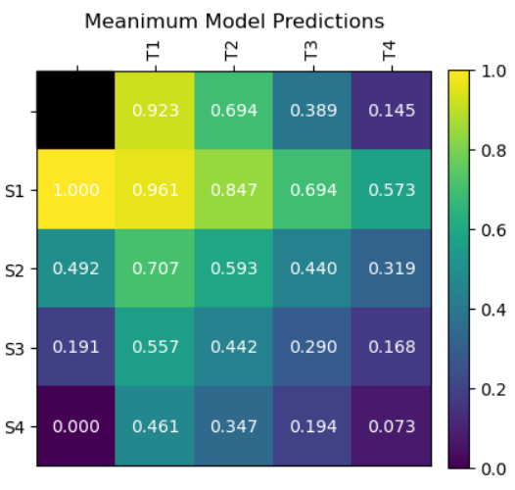
Mean Model
8 Parameters (s1, s2, s3, s4, t1, t2, t3, t4)
Defined as: mean(sLevelValue, tLevelValue).

Slide 9
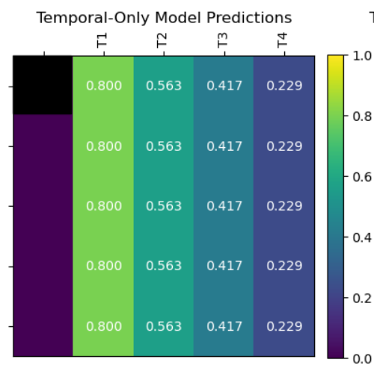
Temporal-Only Model
4 Parameters (t1, t2, t3, t4)
Defined as: tLevelValue.

Slide 10
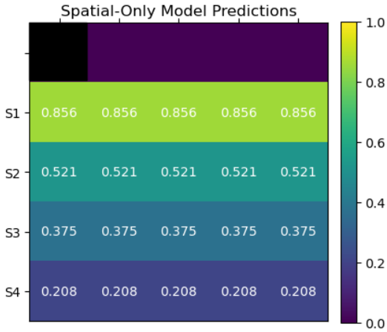
Spatial-Only Model
4 Parameters (s1, s2, s3, s4)
Defined as: sLevelValue.

Slide 11
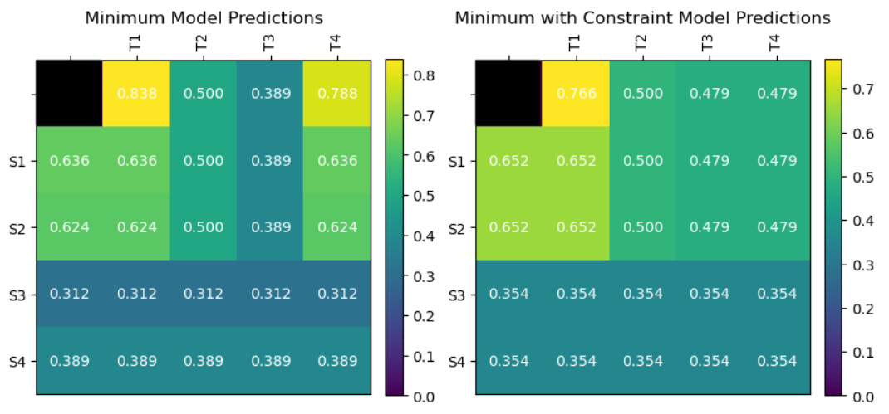
Constraint
Separate models with added constraint that force the following:
t1 > t2 > t3 > t4 s1 > s2 > s3 > s4
Subject 167 →

Slide 12
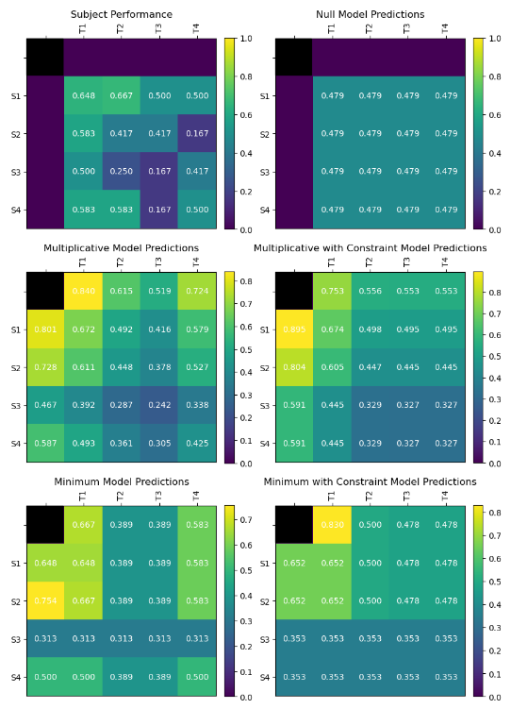
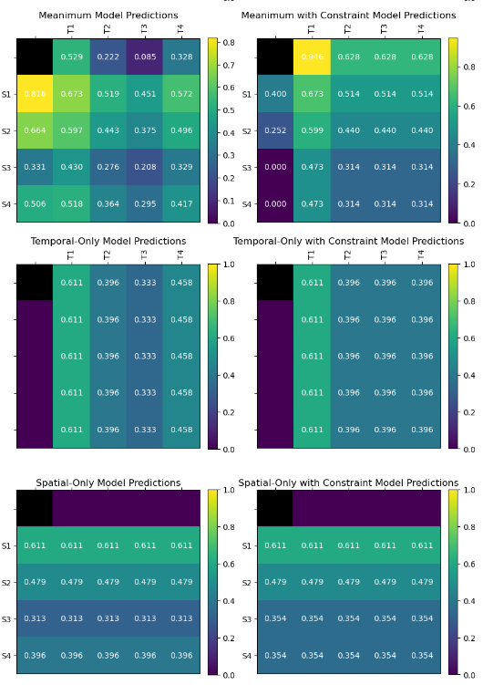
Subject 167

Slide 13
Model Evaluation
BADS optimizer
Objective Function

Slide 14
Bayesian Adaptive Direct Search (BADS) Optimizer
x0 = [0.5 0.5 0.5 0.5] % Starting points (multiple starting points % were used to avoid local minimums)
lb = [0 0 0 0] % Lower bounds
ub = [1 1 1 1] % Upper bounds
plb = [0.5 0.3 0.1 0] % Plausible lower bounds (was not used due % to high variance between subjects)
pub = [1 0.9 0.7 0.6] % Plausible upper bounds (was not used due % to high variance between subjects)
nonbcon = @nonbcon % Non-bound constraint function
bads(objective_function, x0, lb, ub, plb, pub, nonbcon)

Slide 15

Objective Function
The function we want our optimizer to minimize.
We usually want to minimize cost/loss functions and maximize likelihood functions.
Here we used a log-likelihood function but since BADS is a minimizing optimizer we used the negative log-likelihood function.
y = answer (1 or 0)
y^ = model prediction (0-1)
The closer the model prediction is to the answer the bigger the likelihood, therefore, the higher the negative likelihood.

Slide 16
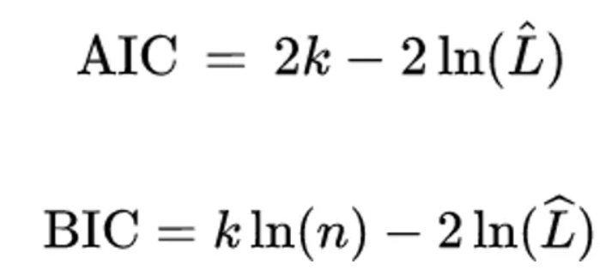
Model Comparison
Akaike Information Criterion (AIC) & Bayesian Information Criterion (BIC)
k = number of parameters n = number of data points L^ = likelihood
Since ln(n) is greater than 2 if n >= 8, the difference between the two is that BIC punishes a higher number of parameters more than AIC.
“ΔBIC magnitudes between 2 and 6, between 6 and 10 and > 10 are considered positive, strong and very strong evidence (respectively) for the model with the lower BIC value” (Feigin & Baror, 2021).

Slide 17
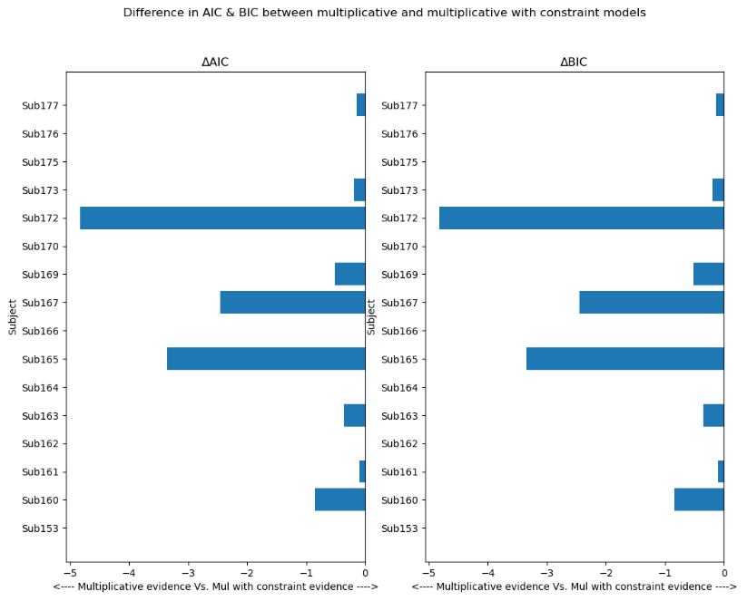
Multiplicative Vs. Multiplicative with constraint

Slide 18
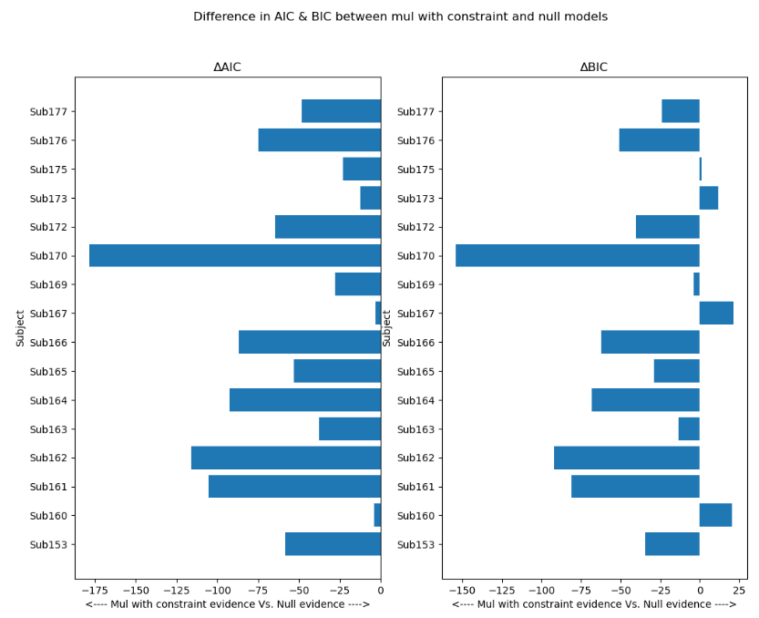
Multiplicative With constraint Vs. Null

Slide 19
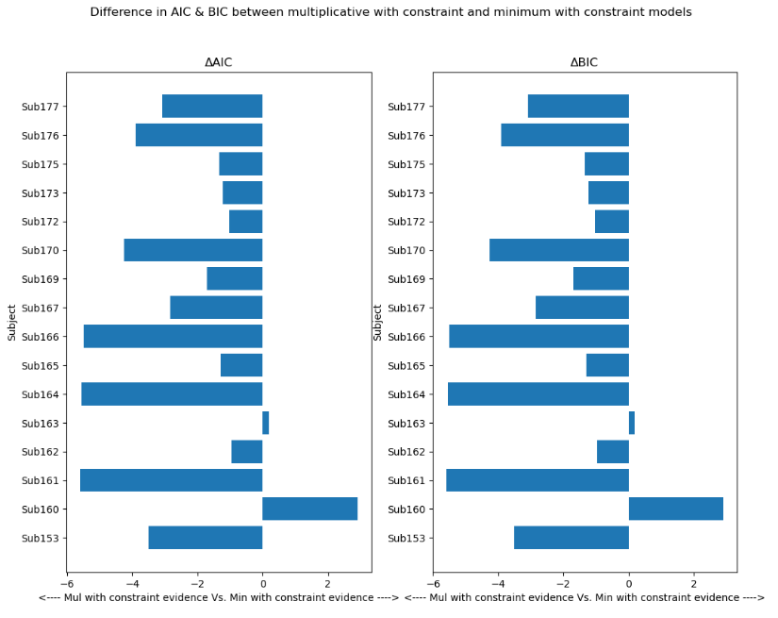
Multiplicative with constraint Vs. Minimum with constraint

Slide 20
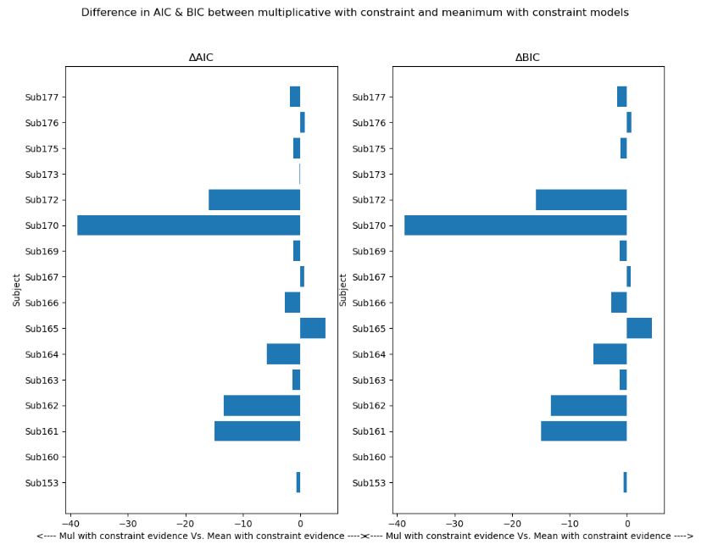
Multiplicative with constraint Vs. Mean with constraint

Slide 21
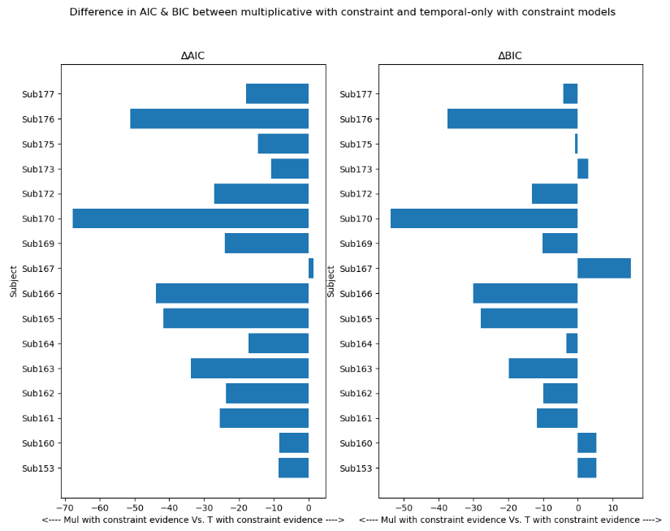
Multiplicative with constraint Vs. Temporal-only with constraint

Slide 22
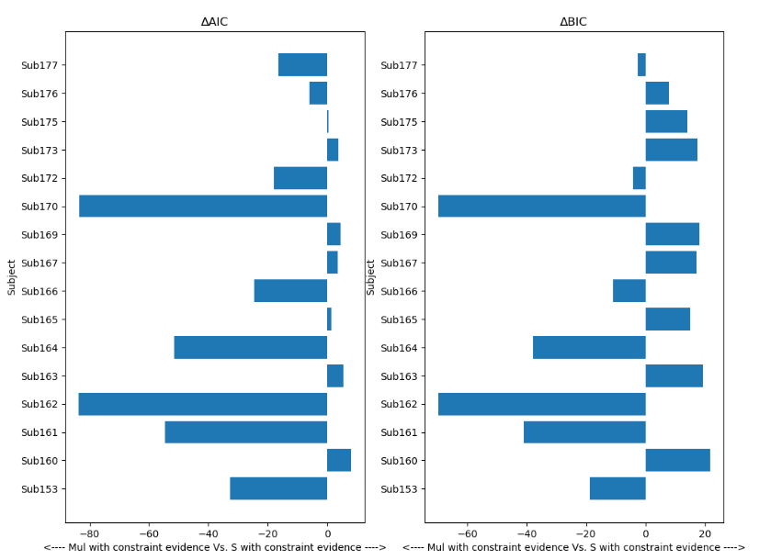
Multiplicative with constraint Vs. Spatial-only with constraint

Slide 23

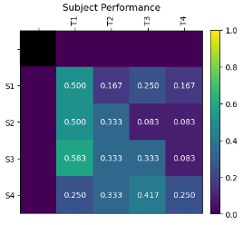
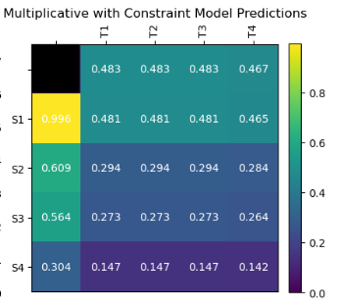
Subject 160 performance
Research Assistant Notes:
“היה לנבדק הרבה יותר קל לזהות את השינויים המרחביים מאשר את השינויים הטמפורליים."

Slide 24
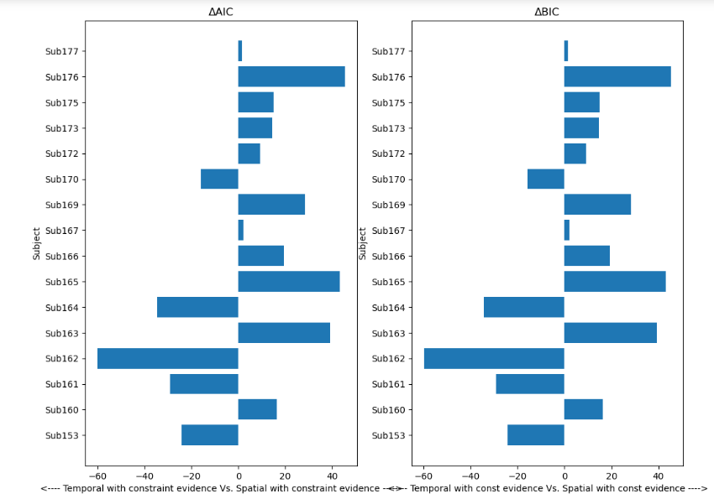
Temporal-only with constraint Vs. Spatial-only with constraint
Problem with the experiment (?)
Less confidence in modal (?)
Less experience with modal (?)

Slide 25
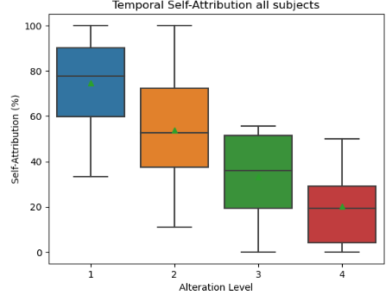
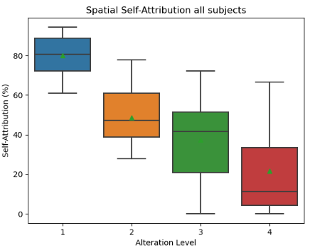
Temporal and Spatial performance

Slide 26
Code review (MATLAB, Python)
Pre-registration
Organize project & transfer knowledge

Slide 27
Bonus

Slide 28
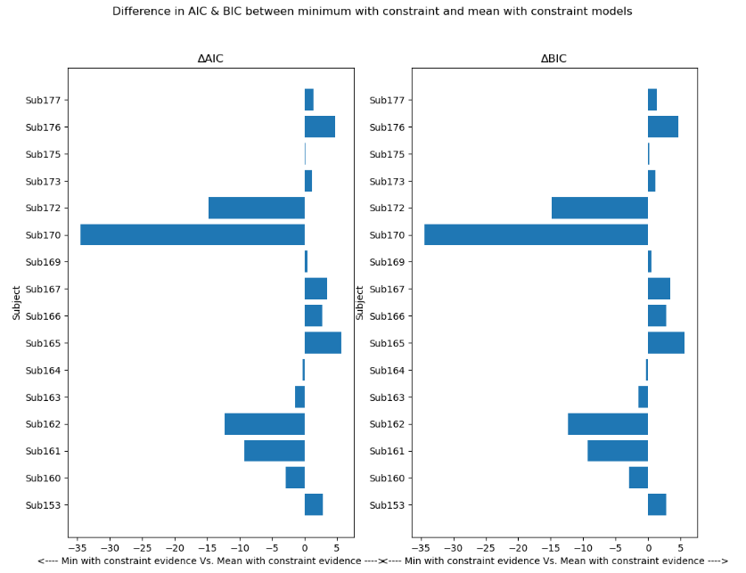
Min with constraint Vs. Mean with constraint

Slide 29
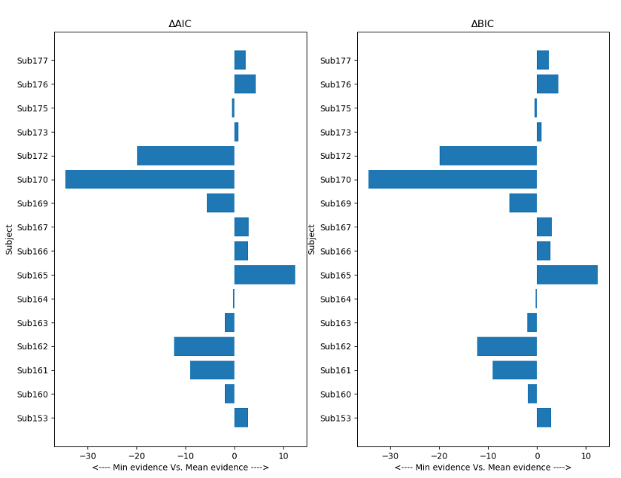
Min Vs. Mean

Slide 30
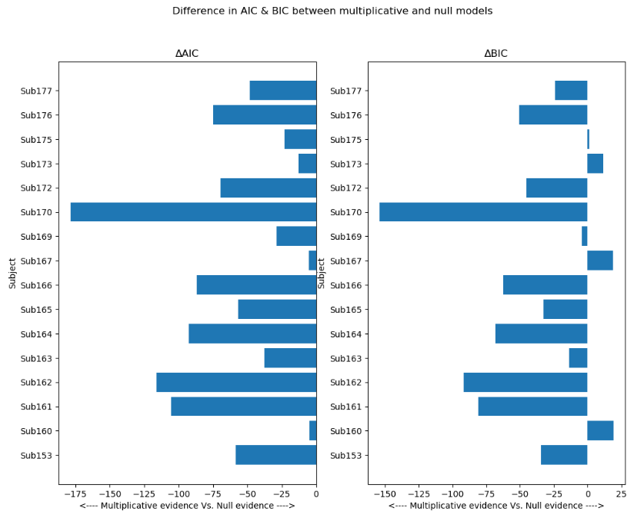
Multiplicative Vs. Null

Slide 31
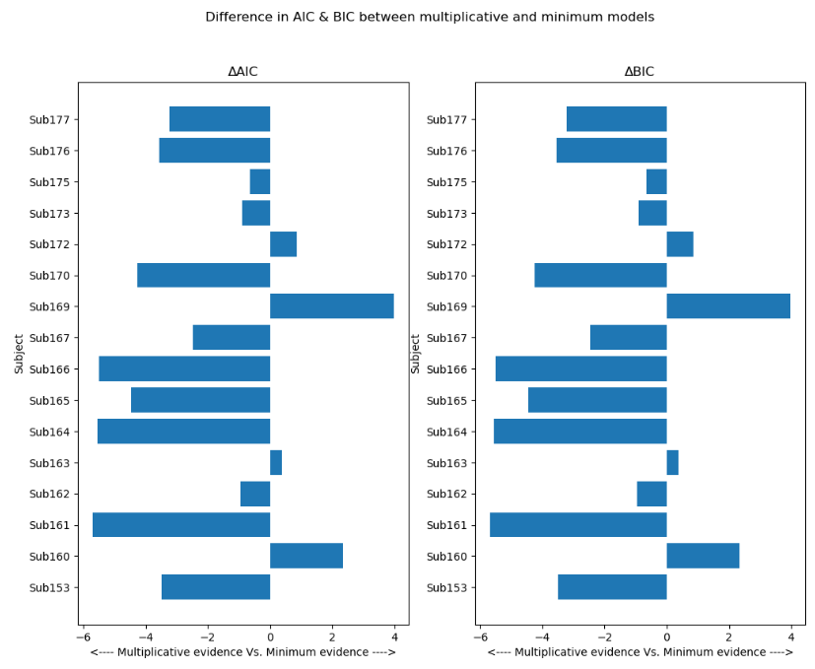
Multiplicative Vs. Min

Slide 32
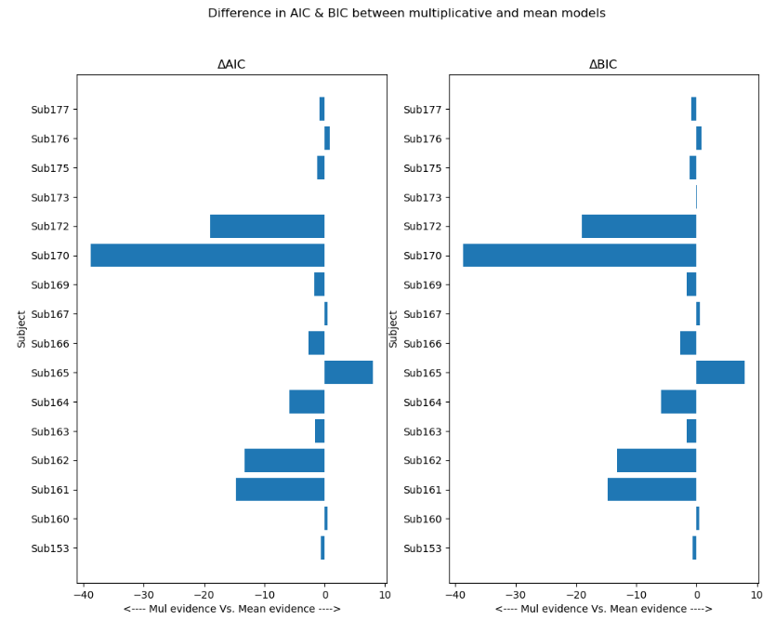
Multiplicative Vs. Mean

Slide 33
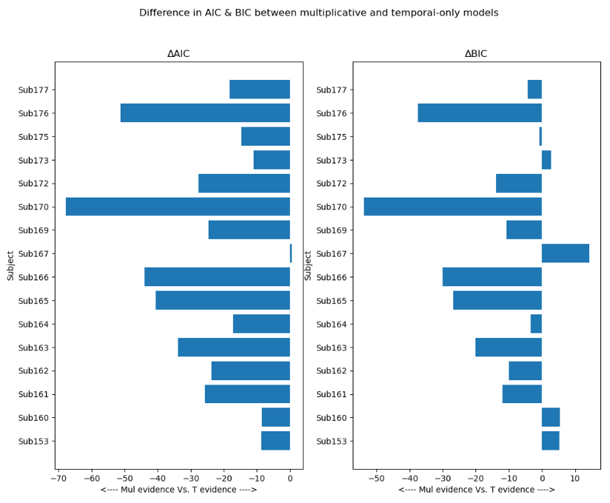
Multiplicative Vs. Temporal-Only

Slide 34
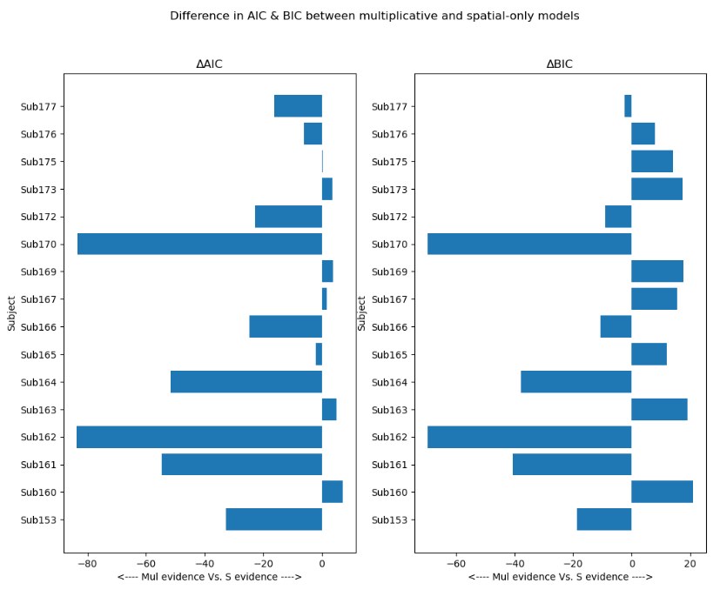
Multiplicative Vs. Spatial-Only

Slide 35
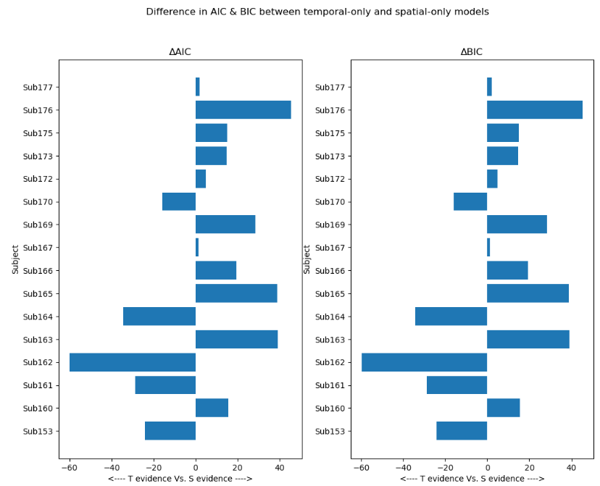
Temporal-Only Vs. Spatial-Only

